Slide 1
Introduction to Windows Networking
IOS110

Slide 2
Objectives
Plan a Windows Server networking model
Understand and implement networking protocols used by Windows Server
Configure TCP/IP
Use TCP/IP tools to troubleshoot network connections
Hands-On Microsoft Windows Server 2008

Slide 3
Planning a Windows Server Networking Model
Network
  A communications system enabling computer users to share computer equipment, application software, and data, voice, and video transmissions
  Contains computers joined by communications cabling or sometimes by wireless devices
Local area network (LAN)
  A network of computers in relatively close proximity
Wide area network (WAN)
  A network of computers spread over a large area
Hands-On Microsoft Windows Server 2008
Notes:
http://compnetworking.about.com/od/basicnetworkingconcepts/a/network_types.htm
LAN - Local Area Network
A LAN connects network devices over a relatively short distance. A networked office building, school, or home usually contains a single LAN, though sometimes one building will contain a few small LANs (perhaps one per room), and occasionally a LAN will span a group of nearby buildings. In TCP/IP networking, a LAN is often but not always implemented as a single IP subnet . In addition to operating in a limited space, LANs are also typically owned, controlled, and managed by a single person or organization.
WAN - Wide Area Network
As the term implies, a WAN spans a large physical distance. The Internet is the largest WAN, spanning the Earth.
A WAN is a geographically-dispersed collection of LANs. A network device called a router connects LANs to a WAN. In IP networking, the router maintains both a LAN address and a WAN address.
A WAN differs from a LAN in several important ways. Most WANs (like the Internet) are not owned by any one organization but rather exist under collective or distributed ownership and management. WANs tend to use technology like ATM, Frame Relay and X.25 for connectivity over the longer distances.
LAN, WAN and Home Networking
Residences typically employ one LAN and connect to the Internet WAN via an Internet Service Provider (ISP) using a broadband modem . The ISP provides a WAN IP address to the modem, and all of the computers on the home network use LAN (so-called private ) IP addresses. All computers on the home LAN can communicate directly with each other but must go through a central gateway , typically a broadband router , to reach the ISP.

Slide 4
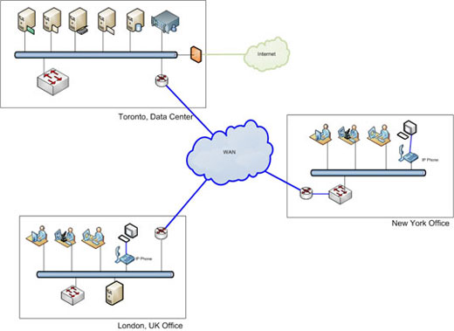
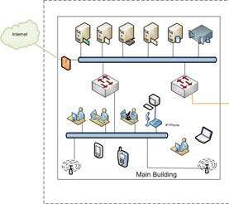
WAN and LAN
Hands-On Microsoft Windows Server 2008

Slide 5
Planning a Windows Server Networking Model
Peer-to-peer networking - WORKGROUP
  Uses workstations to share resources such as files and printers and to connect to resources on other computers
Server-based networking - DOMAIN
  Centralizes the network administration on one or more servers
Hands-On Microsoft Windows Server 2008
Notes:
http://winsupersite.com/article/windows-server/windows-server-2012-essentials-domain-workgroup-144357
Workgroups and Domains
I assume that virtually everyone reading this article has a home network of some kind, with wired and/or wireless connectivity to two or more PCs. You may have never really considered what this sort of network “is,” but in Microsoft networking parlance, that’s type of network is called a workgroup. In a workgroup, each PC is essentially a standalone unit, with its own users, configurations, applications, and so on. To manage such a PC, you typically access it physically, sign in, and get to work.
Naturally, once you’ve got two or more PCs networked together, the notion of sharing resources comes up. Each PC has its own storage, with whatever files—a media collection, perhaps, documents, whatever—and some PCs may be connected to a printer. So Windows, like other PC operating systems, has evolved various ways to share these resources. Printer sharing is probably pretty well understood. And there are different ways in which you can share folders on a PC with others on the home network.
Some folder sharing techniques are sophisticated but tedious: You could manually configure which individual users can access each shared folder on each PC. Some are simple but dumb: You could simply sign in to each PC with the same exact user name/password combos. Some are a bit more seamless, as with the homegroup sharing scheme Microsoft introduced in Windows 7; this works within the workgroup networking type to make sharing folders (and printers) easier.
Workgroups make sense in very small environments, like your home, or a small business with less than 10 PCs. But once you scale up beyond that, managing users and sharing, and other things like PC configurations and application installs, gets difficult. For this reason, Microsoft and other firms have created directory services, which centralize the management of users and their settings, PCs, applications, and other resources through a server or group of servers that work in tandem. Microsoft’s directory service is called Active Directory.
Active Directory (which is the role/service that makes the domain) debuted in Windows 2000 and has been evolving and maturing ever since. An environment based on Active Directory (AD) is called a Windows domain, or just a domain, and this entity defines a collection of resources. These include users, of course, but also PCs, services, and other objects, and the relationships between them. In fact, one way to view a domain is via the security rights that each user is provided: These rights control access to various domain assets. But basically, AD is just a formal, centralized way to manage a network, or computing environment.
Let’s put this in real world terms and say you have a home or small business with five PCs. Each PC will typically be used by a single and different user, but you may have instances in which users want to move around, and use different PCs.
On a workgroup, you would need to manually configure each PC with user accounts for each user. If you literally had to create five identical user accounts on each PC, this can get tedious, though it arguably only has to be done once. But that doesn’t resolve issues such as installing applications—once per PC—configuring those applications on a per user basis—which would have to happen five times on each PC, manually—or making sure that each PC was up to date with security software. And what about changing passwords over time? You’d have to do that manually, on each PC.
Even this simple environment could benefit from a domain, assuming you can handle the complexity of the configuration and the cost of a server and its OS. The user accounts would be managed centrally, so any user could walk up to any PC at any time and sign-in: The sign-in would go through the AD server(s), and if the password was changed once, it would be up to date via any of the PCs, automatically. Applications can be deployed through AD (and related management tools), and kept up to date, as can Windows. And you can specify security policies—and many other useful things—though an AD construct called Group Policy.
Sounds great, right? There’s just one problem: AD is hard. On traditional Windows Server installs, AD is difficult to set up correctly and requires some IT pro expertise. The AD structure itself can be fairly complex; hierarchical and somewhat non-intuitive to newcomers. And ideally, a healthy AD environment would include at least two servers, which are called domain controllers, to replicate the AD database and provide some basic form of disaster recovery.

Slide 6
Peer-to-Peer Networking WORKGROUP
Advantages
Disadvantages
No special equipment needed to enable workstations to communicate and share resources
Can be effective for very small networks (less than 10)
Management of network resources is decentralized
slow response times because workstations are not optimized for multiple user access
As the network increases in size, administration becomes more difficult
Hands-On Microsoft Windows Server 2008

Slide 7
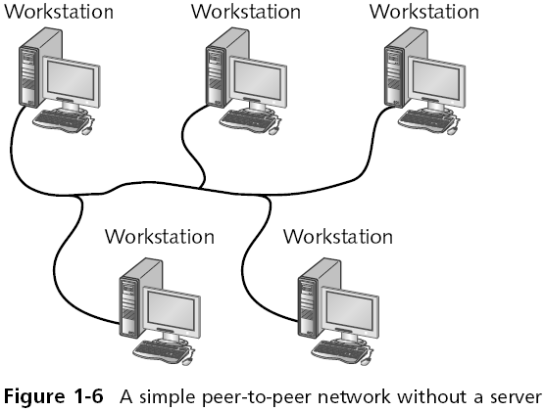
Peer-to-Peer Networking WORKGROUP
Hands-On Microsoft Windows Server 2008

Slide 8
Server-Based Networking - DOMAIN
Advantages
Disadvantages
Users only need to log on once to gain access to network resources
Centralized administration
Fast response times when delivering shared resources
Better security
Scalable
Expensive
  Special hardware and software
  Expertise/support

Slide 9
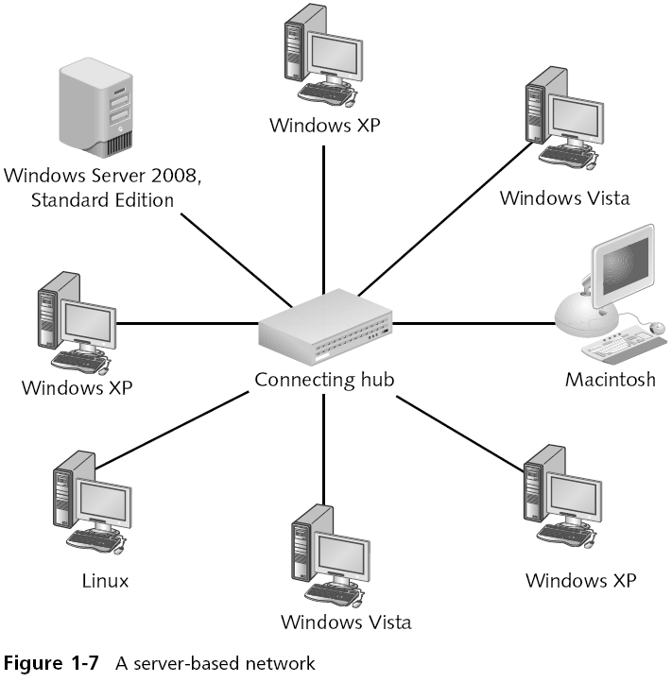
Server Based Network - DOMAIN
Domain Controller
Hands-On Microsoft Windows Server 2008

Slide 10
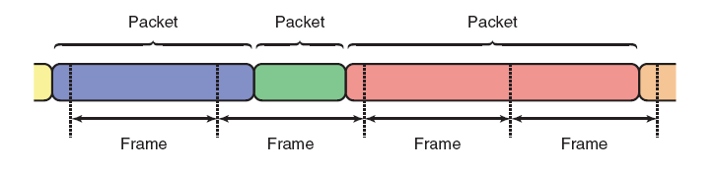
Protocols for the Windows Server Networking Model
A protocol consists of guidelines for how data is formatted and transmitted and decoded across a network or networks
Packets and frames
  Units of data transmitted from a sending computer to a receiving computer
Hands-On Microsoft Windows Server 2008

Slide 11
TCP/IP
TCP/IP is the default protocol installed with current versions of Windows.
TCP/IP is a networking protocol made up of dozens of smaller protocols
Two are considered the most important:
  Transmission Control Protocol (TCP.
  Internet Protocol (IP)
Hands-On Microsoft Windows Server 2008

Slide 12
Transmission Control Protocol
TCP
Provides for reliable end-to-end delivery of data by controlling data flow
TCP is also considered a connection-oriented protocol
  Ensures that packets are delivered, that they are delivered in the right sequence, and that their contents are accurate
Hands-On Microsoft Windows Server 2008

Slide 13
Internet Protocol - IP
Provides network addressing to ensure data packets quickly reach the correct destination
Two versions: IPv4 and IPv6
  IPv4 is used by default on most networks
IP also provides for routing data over different networks
  Routing is accomplished through a device called a router
IP also handles fragmenting packets
Hands-On Microsoft Windows Server 2008

Slide 14
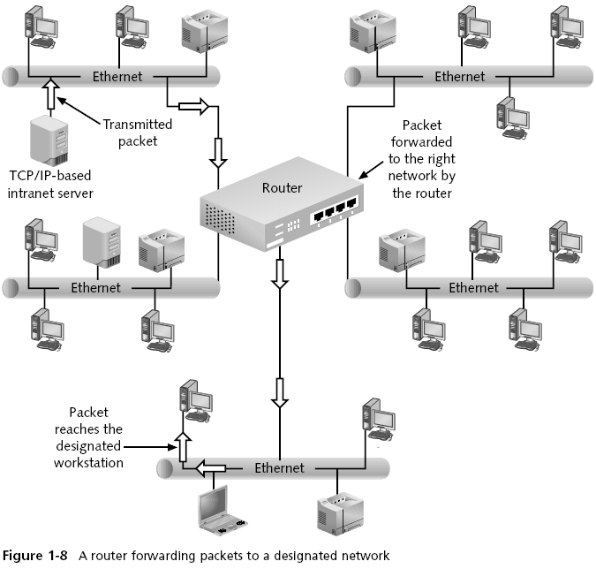
A Router Forwarding Packets
Hands-On Microsoft Windows Server 2008

Slide 15
TCP/IP Configuration
Required TCP/IP settings
  IP Address
  Subnet Mask
  Default Gateway
  Preferred DNS Server
Settings may be configured Automatically or Manually

Slide 16
TCP/IP Configuration
  IP Address - 32 bits long and contains four fields of decimal values representing eight-bit binary octets, allowing numbers between 0 and 255. Each address is unique worldwide
  Subnet Mask - Used for network and host identification
  Shows the class of addressing used
  Divides a network into subnetworks or subnets to control network traffic
Hands-On Microsoft Windows Server 2008

Slide 17
IP Addressing
Network identifier Host identifier
Example: IP Address 142.204.34.136
  Subnet Mask 255.255.0.0
Hands-On Microsoft Windows Server 2008

Slide 18
IP Addressing – special addresses
The network number 127.0.0.0 cannot be assigned to any network
  The address 127.0.0.1 is known as the loopback address
No one can use private IP addresses on the Internet
  Designed for use on a private network behind a Network Address Translation (NAT) device
Cannot assign a network number to a computer or any other host on the network
Cannot assign the highest number on a network to a host
  interpreted as a broadcast message and all computers on the subnet would receive the packet
Hands-On Microsoft Windows Server 2008

Slide 19
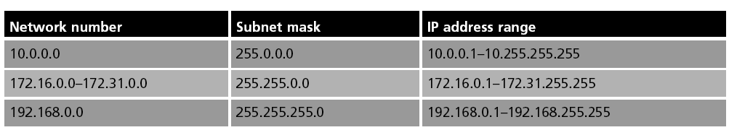
Private/Reserved IP Network Numbers
Private addresses cannot be used on the Internet
Can only be used on private networks, behind a router or device that provides Network Address Translation
Hands-On Microsoft Windows Server 2008

Slide 20
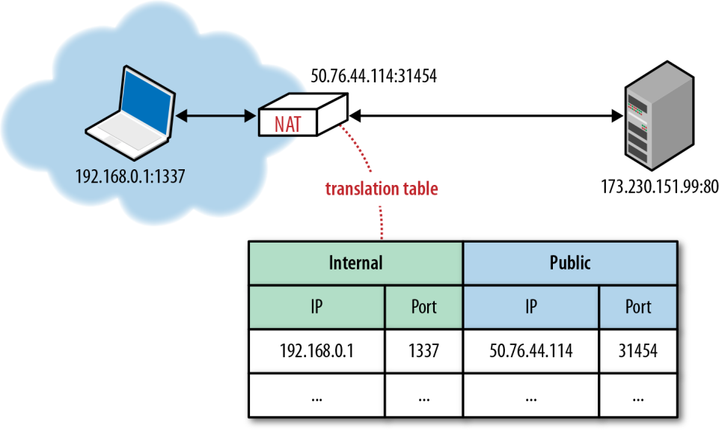
Network Address Translation
Notes:
http://computer.howstuffworks.com/nat.htm
From Cisco website:
Q. What is NAT?
A. Network Address Translation (NAT) is designed for IP address conservation. It enables private IP networks that use unregistered IP addresses to connect to the Internet. NAT operates on a router, usually connecting two networks together, and translates the private (not globally unique) addresses in the internal network into legal addresses, before packets are forwarded to another network.
As part of this capability, NAT can be configured to advertise only one address for the entire network to the outside world. This provides additional security by effectively hiding the entire internal network behind that address. NAT offers the dual functions of security and address conservation and is typically implemented in remote-access environments.
Q. How does NAT work?
A. Basically, NAT allows a single device, such as a router, to act as an agent between the Internet (or public network) and a local network (or private network), which means that only a single unique IP address is required to represent an entire group of computers to anything outside their network.

Slide 21
Internet Protocol Version 6
  Provides a logical growth path from IPv4
  More hosts per network and more network addresses
New features include:
  A 128-bit address capability
  A single address associated with multiple network interfaces
  New IP extension headers that can be implemented for special needs, including more routing and security options
  IPv6 addressing enables one IP identifier to be associated with several different interfaces
    Can better handle multimedia traffic
Hands-On Microsoft Windows Server 2008
Notes:
http://support.apple.com/en-ca/HT202236
(yes, I am really putting an Apple link here ☺)

Slide 22
Static and dynamic addressing
Static addressing (manual configuration)
  Involves assigning a dotted decimal address that becomes each workstation’s permanent, unique IP address
Dynamic addressing (automatic configuration)
  Automatically assigns an IP address to a computer each time it is powered on
  Uses the Dynamic Host Configuration Protocol (DHCP) to assign an IP address to a workstation at startup (and renewals)
Hands-On Microsoft Windows Server 2008

Slide 23
Automatic Address Configuration
Dynamic Addressing Through a DHCP Server
  Common for medium-sized and large networks
  You must first install and configure a DHCP server on the network
  In addition to assigning the IP address, the DHCP server can also assign the subnet mask, default gateway, DNS server, and other IP settings
  Using a DHCP server can save you a great deal of administrative effort
Hands-On Microsoft Windows Server 2008

Slide 24
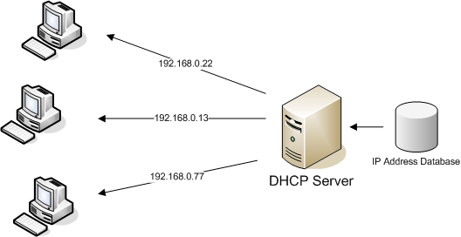
DHCP Overview
DHCP Server is configured with a Range of IP Addresses for the network, a subnet mask, default gateway and preferred DNS server.
Notes:
https://technet.microsoft.com/en-us/library/dd145320%28v=ws.10%29.aspx

Slide 25
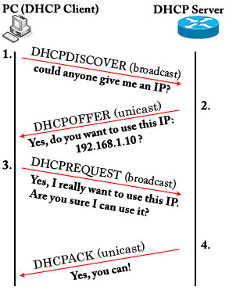
DHCP Process
Client obtains TCP/IP Configuration from the DHCP server at Startup

Slide 26
Automatic Private IP Addressing (APIPA)
Used to automatically configure the TCP/IP settings for a computer without using a DHCP server
Computer automatically assigns itself an IP address from the reserved range of 169.254.0.1 to 169.254.255.254 and a subnet mask of 255.255.0.0
Appropriate for small organizations that have only one network segment
Hands-On Microsoft Windows Server 2008
Notes:
Definition: A feature of Microsoft Windows, APIPA is a DHCP failover mechanism for local networks. With APIPA, DHCP clients can obtain IP addresses when DHCP servers are non-functional. APIPA exists in all modern versions of Windows except Windows NT.
When a DHCP server fails, APIPA allocates IP addresses in the private range 169.254.0.1 to 169.254.255.254. Clients verify their address is unique on the network using ARP. When the DHCP server is again able to service requests, clients update their addresses automatically.
In APIPA, all devices use the default network mask 255.255.0.0 and all reside on the same subnet.
APIPA is enabled on all DHCP clients in Windows unless the computer's Registry is modified to disable it. APIPA can be enabled on individual network adapters.

Slide 27
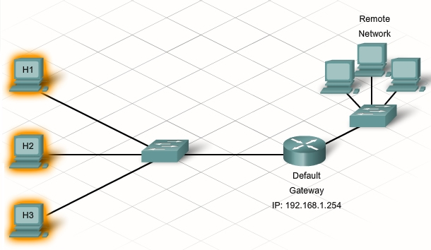
Default Gateway
The IP address of the router that has a connection to other networks
Used when the host computer you are trying to contact exists on another network
Notes:
In computer networking, a default gateway is the device that passes traffic from the local subnet to devices on other subnets. The default gateway often connects a local network to the Internet, although internal gateways for local networks also exist.
Internet default gateways are typically one of two types:
On home or small business networks with a broadband router to share the Internet connection, the home router serves as the default gateway.
On home or small business networks without a router, such as for residences with dialup Internet access, a router at the Internet Service Provider location serves as the default gateway.

Slide 28
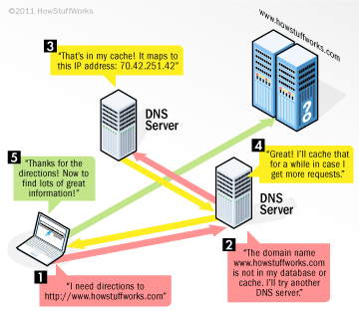
Preferred DNS Server
Domain Name System (DNS)
A TCP/IP application protocol that enables a DNS server to resolve (translate) domain and computer names to IP addresses, or IP addresses to domain and computer names
Hands-On Microsoft Windows Server 2008

Slide 29
Implementing TCP/IP in Windows Server
In order to successfully configure TCP/IP on your network, you must:
  Configure TCP/IP settings
  Verify it is enabled
  Test Connectivity/Configuration (troubleshoot)
Hands-On Microsoft Windows Server 2008

Slide 30
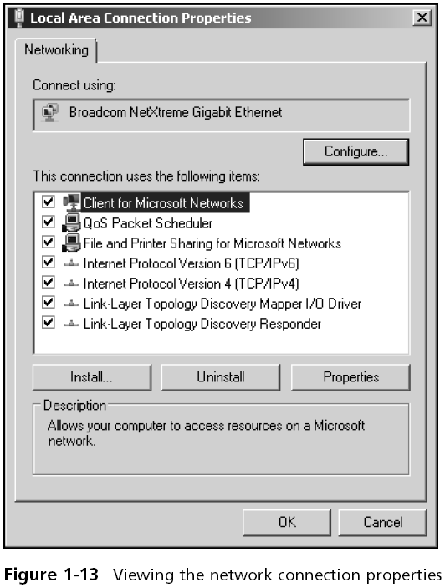
Local Area Connection Properties
Hands-On Microsoft Windows Server 2008

Slide 31
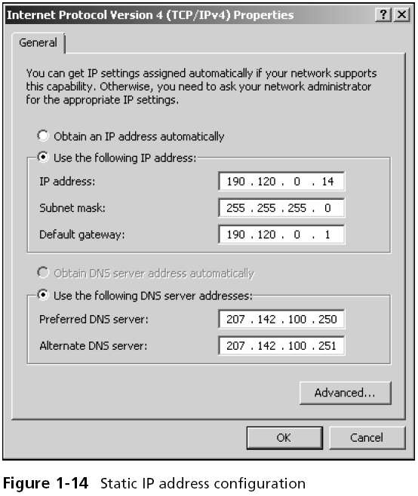
Static IP Address Configuration (Manual)
Hands-On Microsoft Windows Server 2008

Slide 32
Testing a TCP/IP Installation
Ipconfig
Command used to view current TCP/IP configuration
Switches - /all, /release, /renew, /flushdns
Ping
Command used to test connectivity between TCP/IP hosts on a network.
Example: ping 192.168.0.254 or ping hostname
Ping 127.0.0.1 (verifies TCP/IP is installed on the localhost)
Hands-On Microsoft Windows Server 2008

Slide 33
Troubleshooting TCP/IP Connectivity
If you do not have connectivity follow-these-steps to troubleshoot problems:
Type ipconfig to check if your IP address, subnet mask, and default gateway are correct.
Now ping 127.0.0.1 to see if your network adapter is working.
Now ping your own computer's IP address.
Now try pinging the IP address of another computer on the same subnet.
Now try pinging your default gateway (the near-side interface of the router that connects your subnet to the rest of the network).
Now try pinging the IP address of a computer on a different subnet.
Depending on where this process fails will help you determine the problem.

Slide 34
Summary
The two types of networking models used by Windows Server are peer-to-peer (Workgroup) networks and server-based (Domain) networks
TCP/IP is the default protocol installed with Windows
The two versions of IP are IPv4 and IPv6
Every network device, such as a computer or router, must have a unique IP address to ensure network connectivity and the delivery of data
IP addresses can be manually configured using static addressing or automatically configured
Hands-On Microsoft Windows Server 2008

